Slide 1

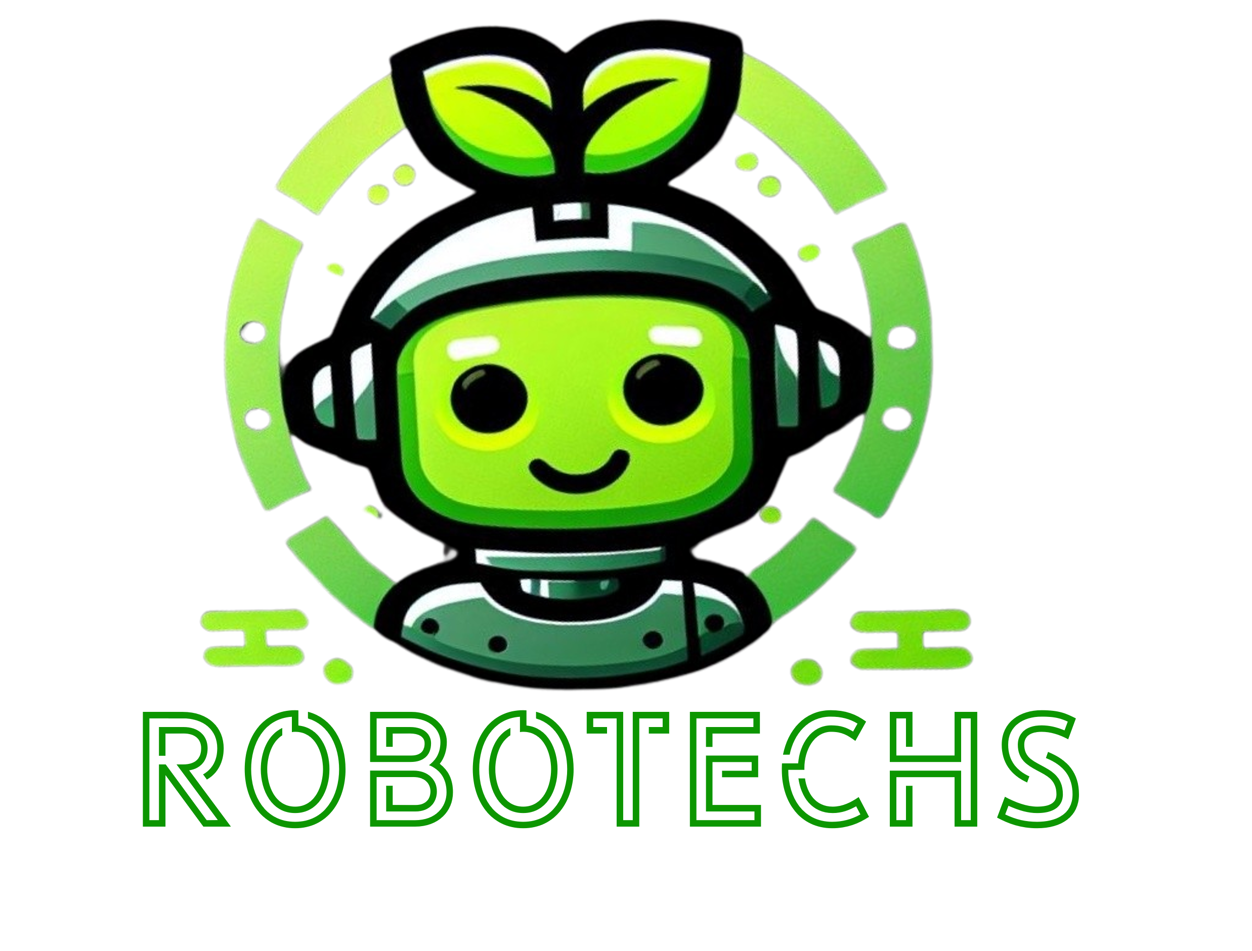
Schneider Electric European Hackathon 2023
Eco-Tech Revolution: Pioneering Solutions for Sustainable Urban Transformation.
Team Robotechs

Slide 2
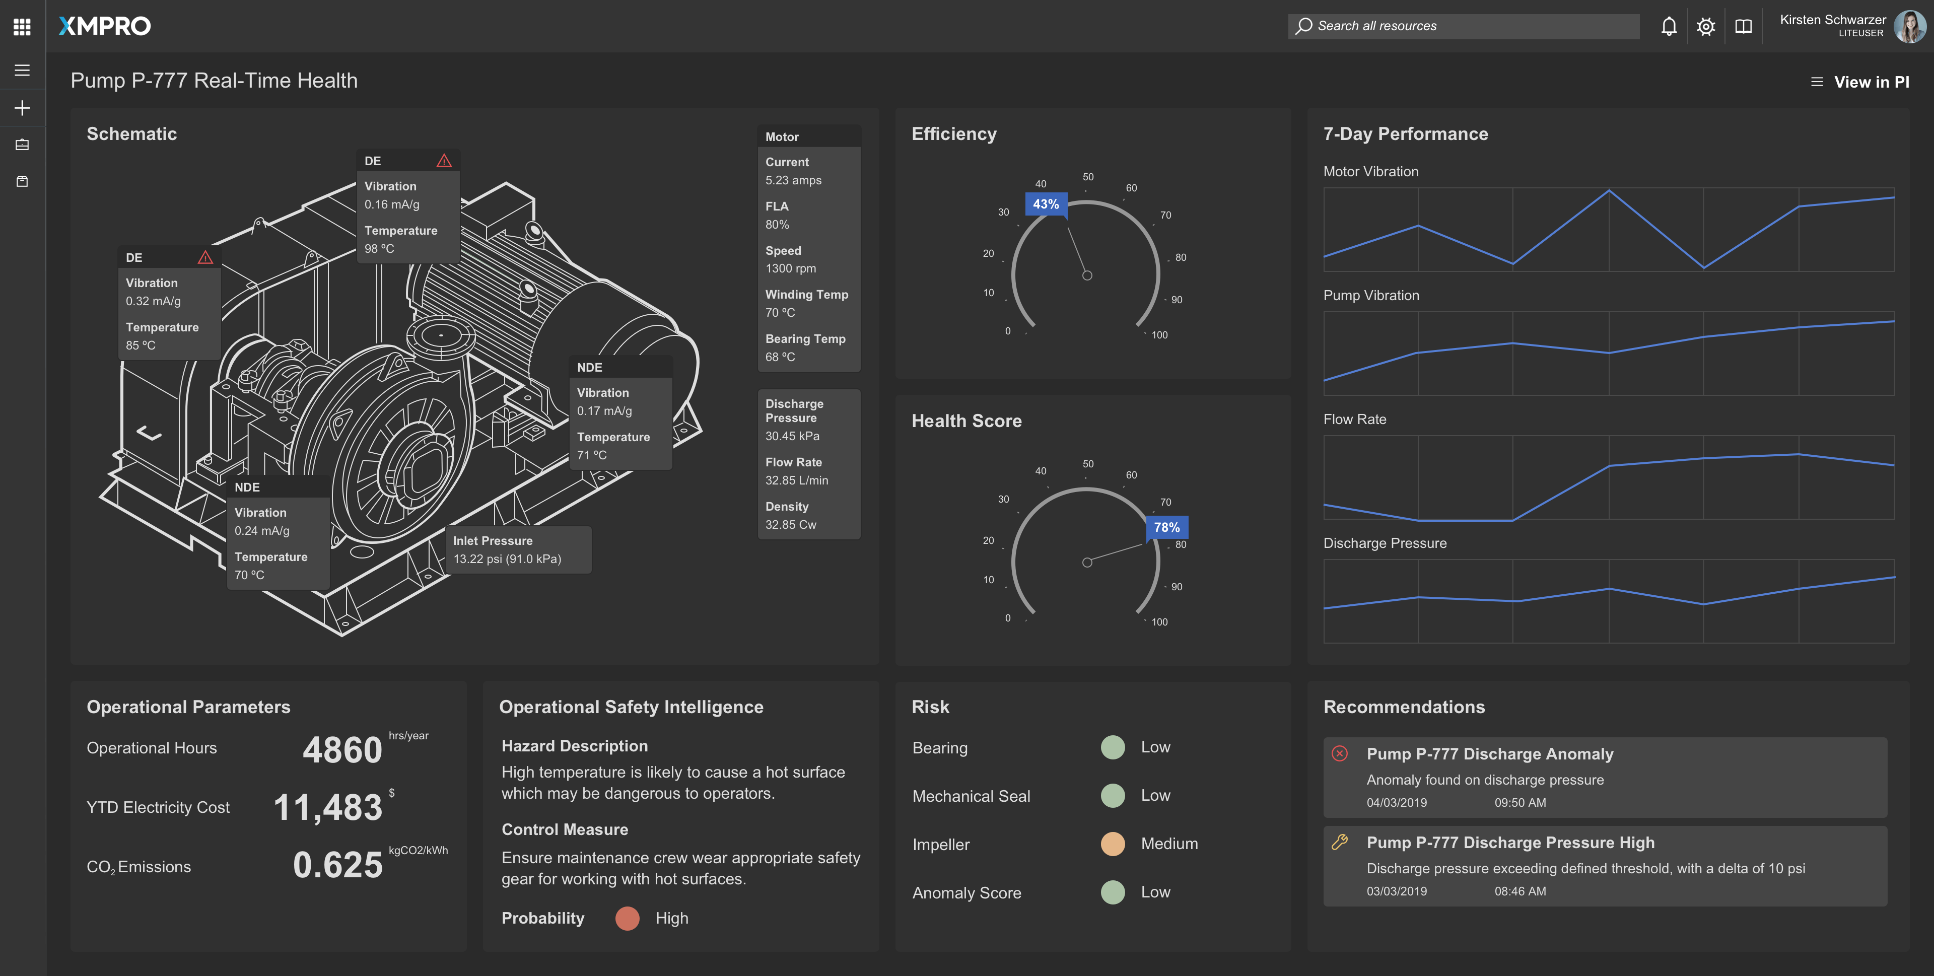
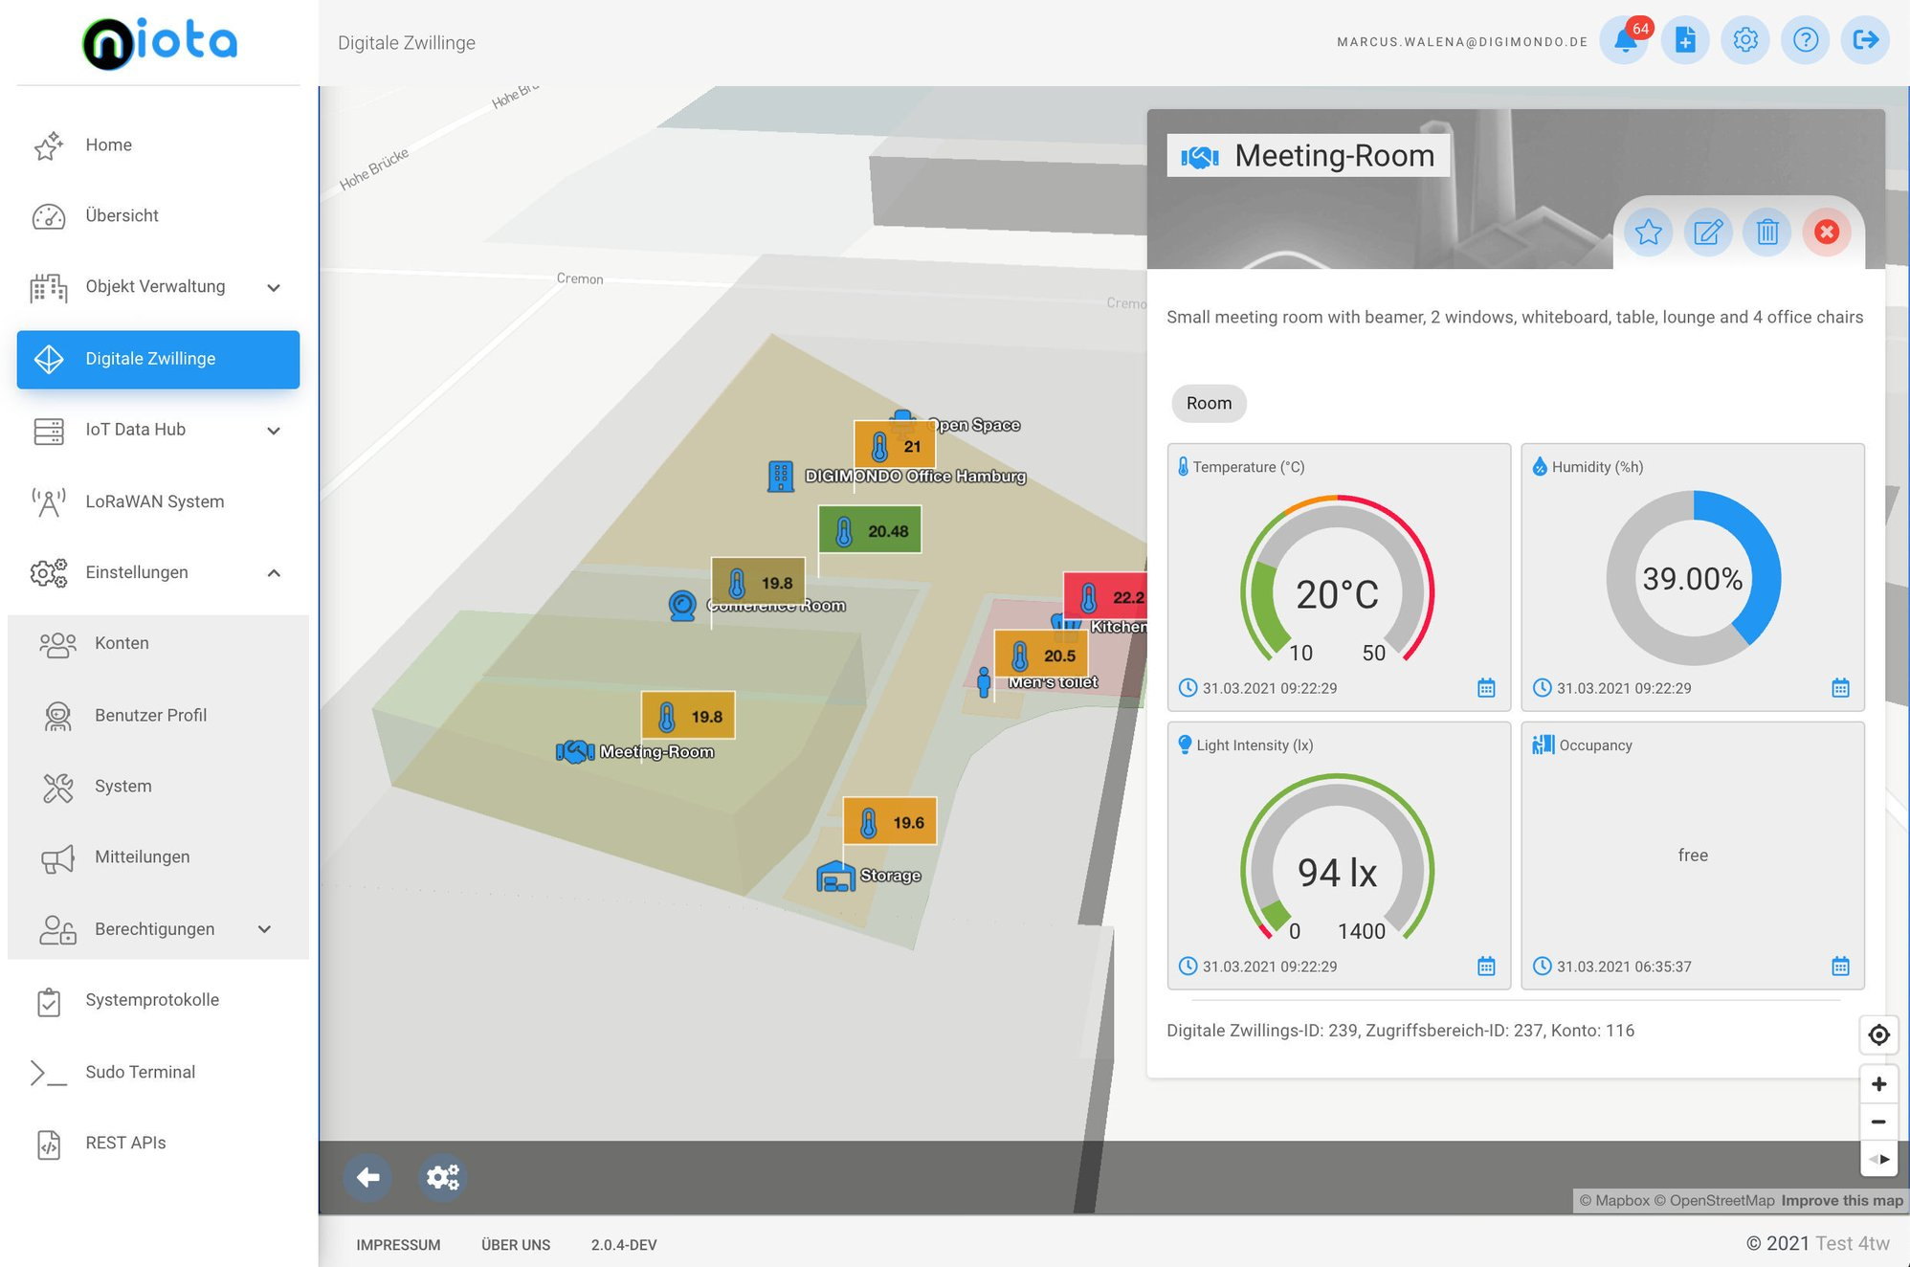
Problem Statement 1 - Enhancing Industrial Safety and Energy Efficiency through Intuitive Plant Monitoring Systems
In contemporary industrial settings, existing plant monitoring systems pose significant challenges for operators, hindering their ability to swiftly comprehend crucial information. The root cause of many of the production issues cannot be identified by looking at a single machine, but on the plant level itself in a big picture. The complexity of identifying tags and interpreting intricate 2D drawings for industrial machinery complicates fault identification and maintenance procedures.
Key Issues:
Complexity in System Understanding: Current plant monitoring systems are often convoluted, making it challenging for operators to interpret vital data, leading to potential operational disruptions. Even in 3D exiting systems focus only on a single machine which is limiting the insights in the operations.
Risk of Energy Loss: Anomalies in machine operation, resulting from difficulties in maintenance identification, contribute to energy losses, undermining the overall efficiency of industrial processes [1].
Safety Concerns: The delay in maintenance procedures presents a severe safety hazard, with the potential for catastrophic consequences, including loss of life and property.
Technical Complexity of Digital Twin Models: Existing digital twin models lack robustness and are inaccessible to personnel with limited technical expertise, impeding effective utilization for predictive maintenance.
Cumbersome Human Machine Interface (HMI): Current HMIs are excessively complex, necessitating intricate navigation steps to implement emergency control measures promptly.
Impact:
The existing challenges in plant monitoring systems not only jeopardize industrial safety but also contribute to energy inefficiency, with the potential for significant economic and environmental consequences.
Reference
[1] S. Diamond, “The Bhopal disaster: How it happened,” The New York Times, https://www.nytimes.com/1985/01/28/world/the-bhopal-disaster-how-it-happened.html (accessed Nov. 22, 2023).
Notes:
Objective:
Develop an advanced and user-friendly plant monitoring system that prioritizes industrial safety, streamlines maintenance procedures, and enhances energy efficiency, ensuring a seamless interface for both technical and non-technical personnel. This innovative solution aims to mitigate risks, minimize downtime, and optimize industrial processes for sustainable and secure operations.

Slide 3
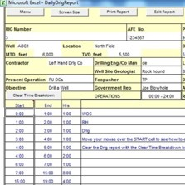
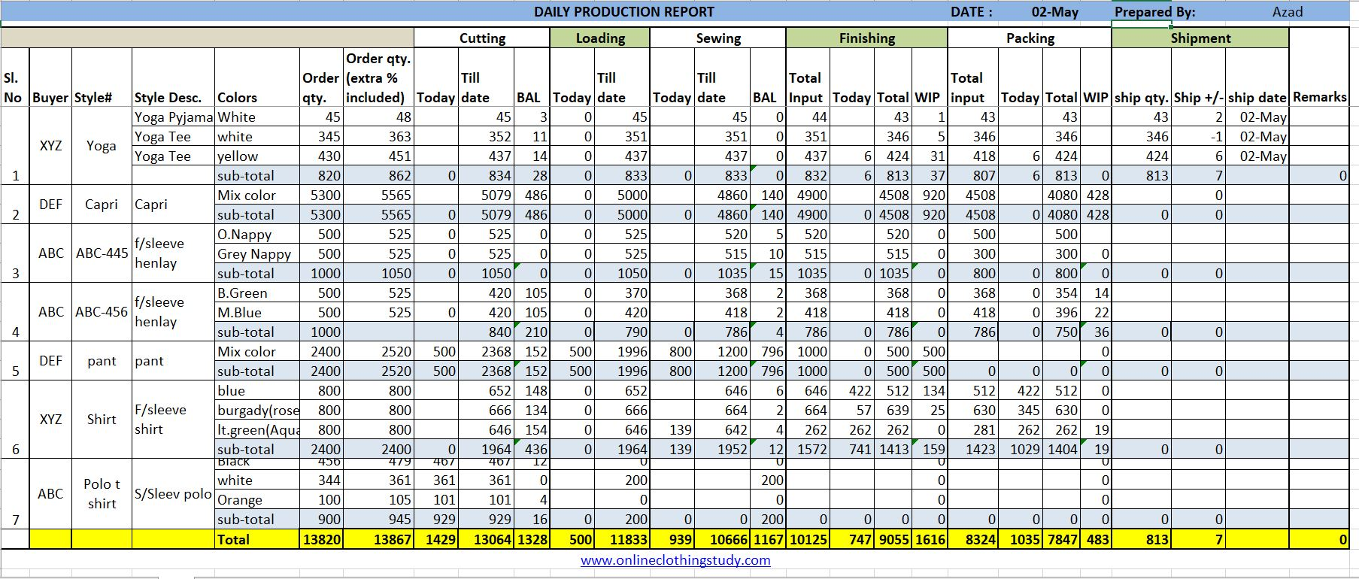

Problem Statement 2 - Revolutionizing Data Accessibility and Interpretation in the Industrial Landscape
In the fast-paced operational environments of today's industries, a growing challenge is the accumulation of unnoticed reports, creating a bottleneck in efficient decision-making processes. This issue is exacerbated by the complexity of data-driven reports, making it difficult for users to extract key insights amid their hectic schedules.
Key Issues:
Report Overload: The industry is grappling with a surge in reports, a significant portion of which goes unnoticed due to the overwhelming demands of the operational environment.
Complex Data Interpretation leading to production and energy loss: In this data-driven era, extracting key summaries from extensive reports poses a challenge, impeding timely decision-making and potentially leading to production and energy losses [2].
Accessibility Challenges: Many users, including those with visual impairments, face difficulties in reading reports, necessitating the use of spectacles and other assistive devices.
Exclusion of Disabilities: Current reports lack inclusivity, failing to cater to individuals with disabilities. This hinders their ability to access and comprehend critical data and analysis.
Decision-Making Delays: The delay in comprehending complex data directly impacts decision-making processes, introducing the risk of production delays and energy inefficiencies.
Impact:
The current scenario not only hampers operational efficiency but also jeopardizes the overall productivity and energy conservation goals of the industry.
Reference
[2] R. H. Ansah and S. Sorooshian, “4P delays in project management,” Engineering, Construction and Architectural Management, vol. 25, no. 1, pp. 62–76, 2018. doi:10.1108/ecam-09-2016-0199

Slide 4
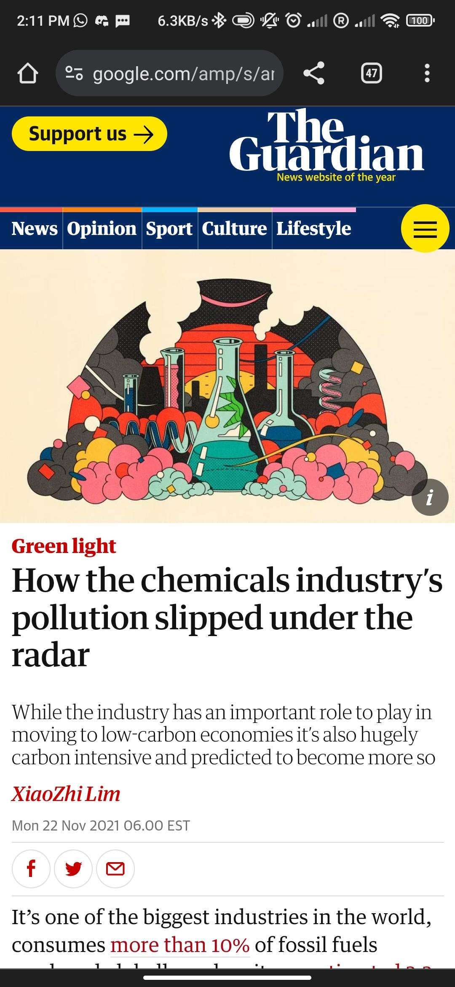
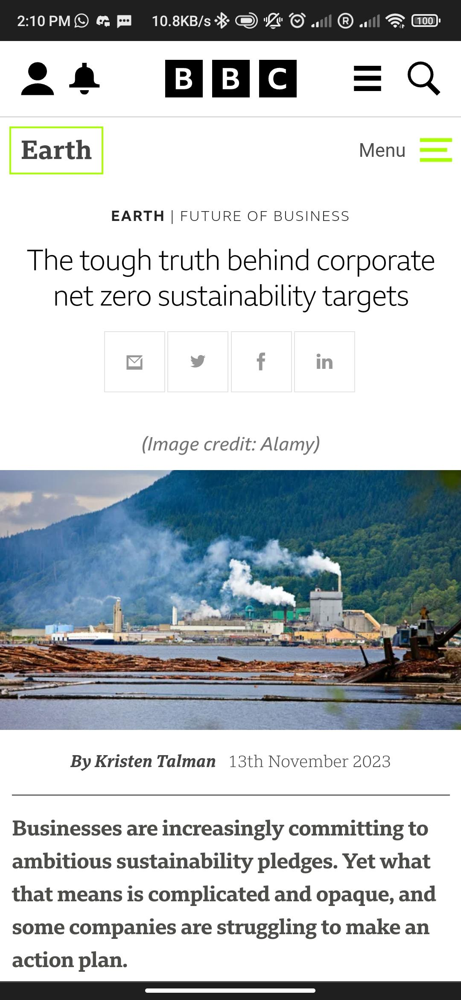
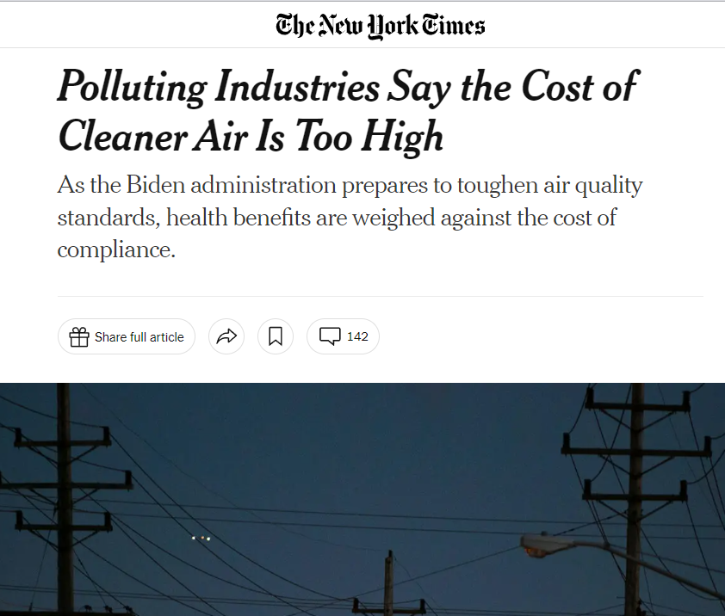
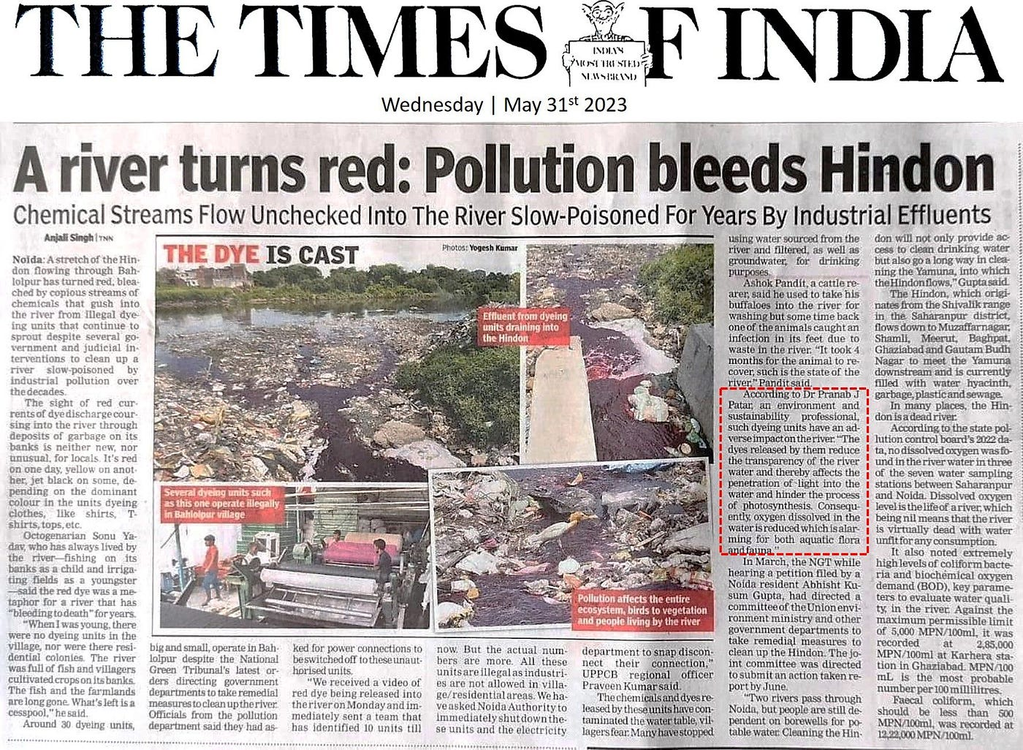
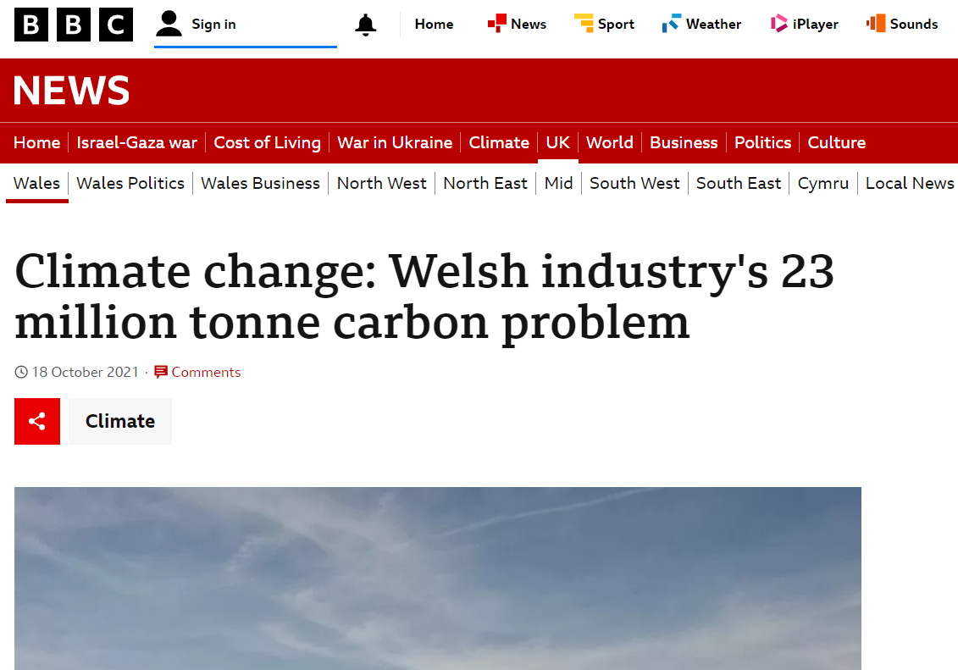
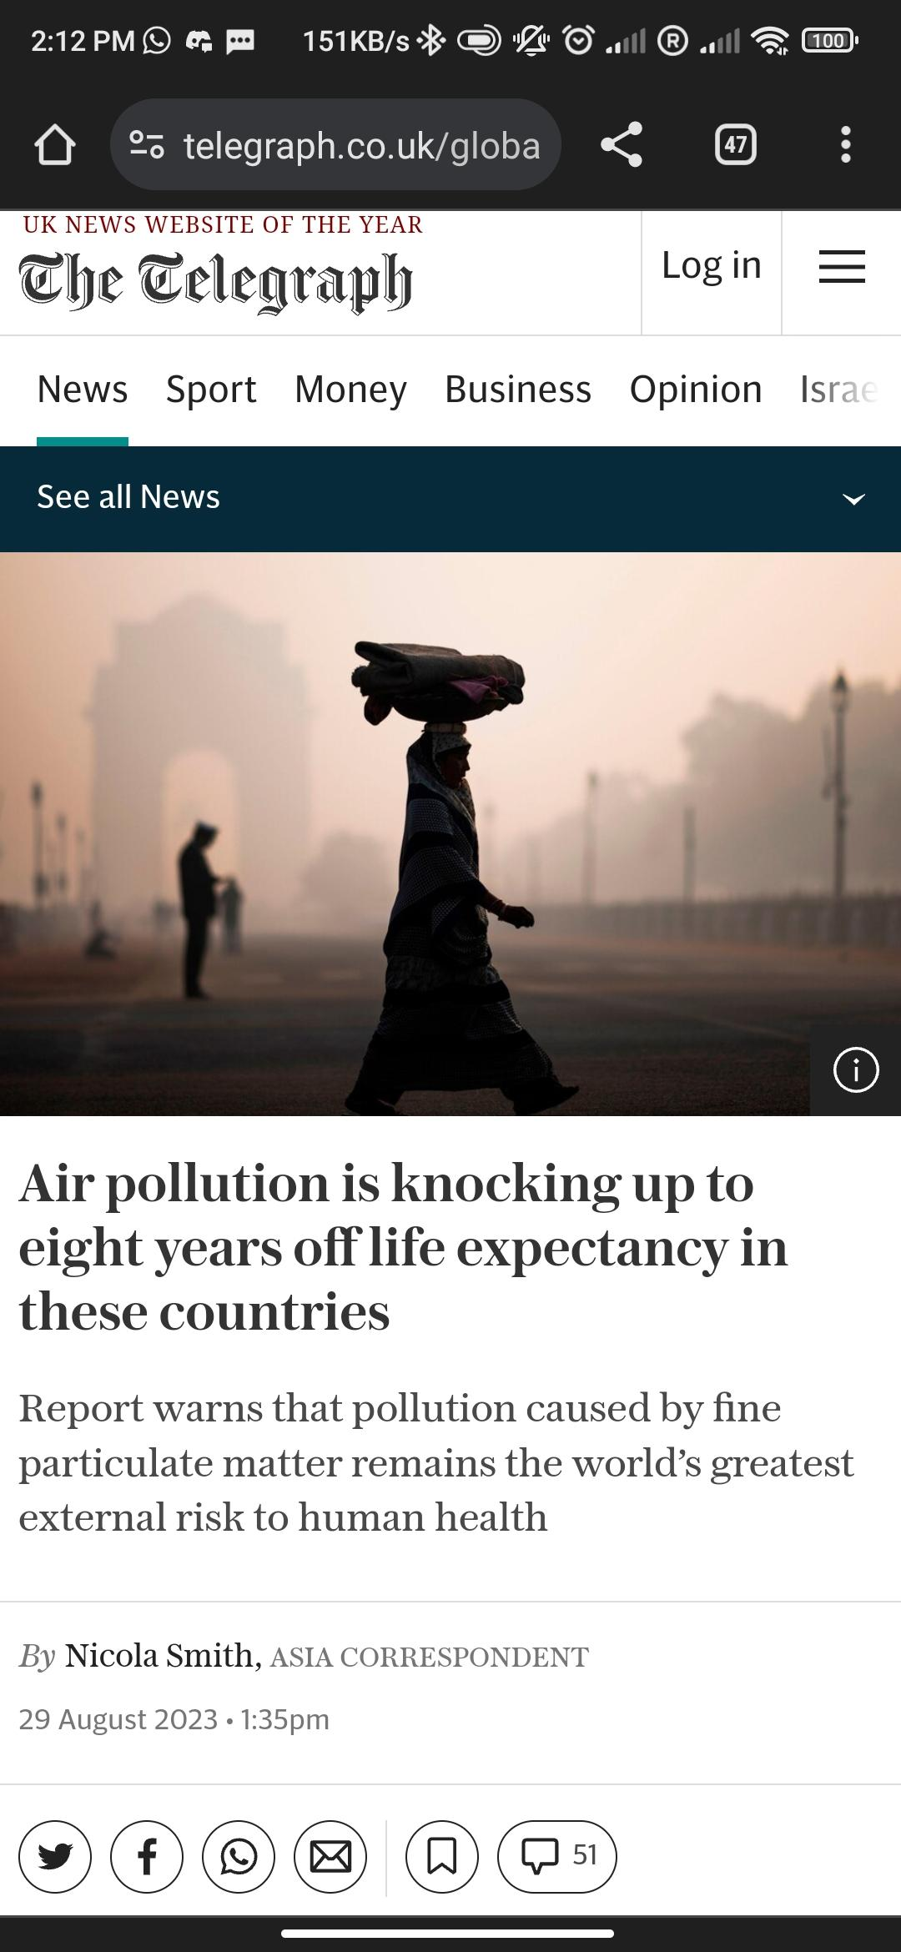
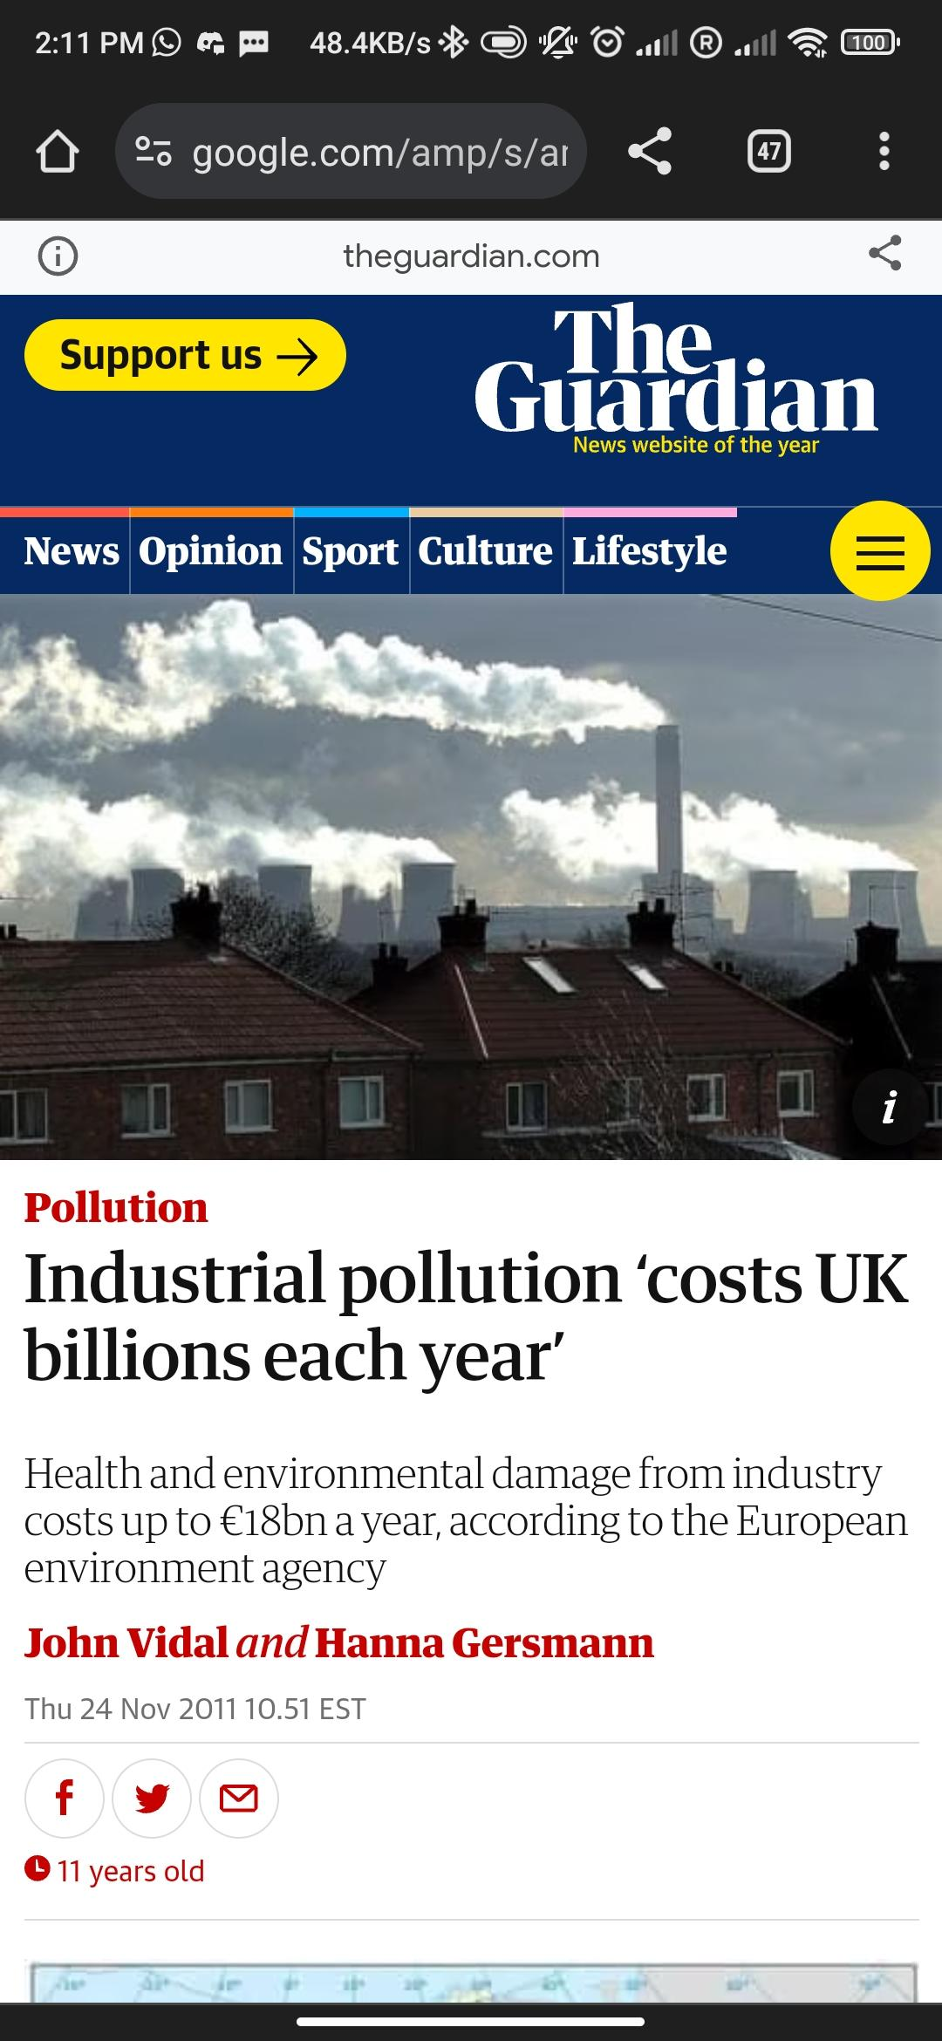

Problem Statement 3 - Advancing Towards Global Net-Zero Goals - Overcoming Implementation Challenges in Industry
As industries worldwide set ambitious targets for achieving net-zero, a common struggle emerges as companies encounter difficulties in effectively implementing sustainable practices within their facilities. Notably, while Schneider Electric's EcoStruxure model has successfully digitalized industrial operations, focusing primarily on optimizing production, it falls short in comprehensively addressing key challenges faced by stakeholders..
Key Issues:
Implementation Hurdles: Companies globally are grappling with the practical implementation of net-zero initiatives within their facilities, encountering barriers that impede progress.
EcoStruxure Limitations: While Schneider Electric's EcoStruxure model has proven effective in enhancing the monitoring and availability of equipment, its primary focus on production optimization neglects other critical challenges faced by stakeholders on the path to sustainability.
Emissions and Energy Loss Correlation: The study of emissions from industrial machines reveals a correlation to energy loss and efficiency degradation in various applications, posing a significant hurdle in achieving net-zero goals [3].
Impact:
The current limitations in addressing holistic sustainability challenges hinder progress toward achieving net-zero goals, affecting not only environmental targets but also the overall efficiency and resilience of industrial operations.
Reference
[3] V. Kolev, I. Draganova-Zlateva, and D. Gospodinova, “Trends in energy efficiency and co2 emissions according to Bulgarian National Energy Efficiency Plan,” 2019 11th Electrical Engineering Faculty Conference (BulEF), 2019. doi:10.1109/bulef48056.2019.9030770

Slide 5



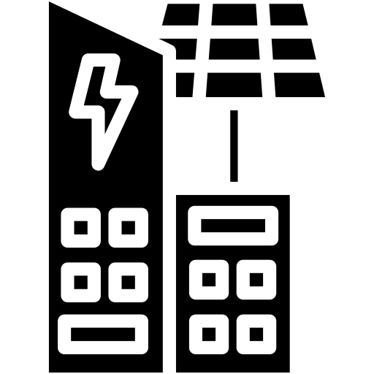

What We Propose?
Software Implementation
Innovate
A 3D digital twin platform that integrates real-time plant operations with advanced data analytics, enabling predictive maintenance insights as well as remote visibility to plant operations.
AI based voice assistant designed to engage seamlessly with personnel without technical expertise, providing real-time updates on plant operations and facilitating maintenance analysis.
Continuous Pollution Monitoring using Industrial Internet of Things (IIoT)
Hardware Implementation
Noise isolation for mitigating sound pollution and harnessing sound energy for sustainable electricity generation.

Slide 6
What We Propose?
Software Implementation
Innovate
3D digital twin platform, which showcase the live plant operations coupled with advanced data analytics.
Ensuring the energy efficiency of a plant necessitates careful attention to each machine, as even minor faults can disrupt operations. The 3D digital twin platform not only provides in-depth insights into machineries without requiring advanced technical knowledge but also leverages the potential of artificial intelligence (AI). In this system the focus is not only on a single machine but to the whole plant in a 3D immersive environment to provide the holistic information about the operations. Its user-friendly interface enables operators to easily access information, presenting a virtual replica for seamless visualization. Additionally, the integration of augmented reality (AR) and virtual reality (VR) enhances the user experience, allowing individuals to immerse themselves in the plant's digital environment. Technicians can conduct routine machine checks online without disrupting plant operations, and the synergy of AI, AR, and VR supports real-time tests, predictive analytics, and proactive fault detection. Company officials can remotely assess the plant's current condition, foresee upcoming maintenance needs, generate reports, and allocate additional funds if necessary. This approach ensures a comprehensive and proactive strategy for plant management, emphasizing energy efficiency and showcasing the innovative use of AI, AR, and VR for sustainable industrial processes, while simultaneously reducing safety risks linked to on-site assessments.
Voice assistant
This AI-powered voice assistant seamlessly integrates with the system database. The utilization of human-machine interaction through the voice assistant streamlines communication between operators and machines, reducing complexity. Its user-friendly interface is designed for easy accessibility, catering to both non-technical users and individuals with disabilities, offering alerts and quick access to technician contact details in case of component faults. With access to the database, the voice assistant can generate real-time plant working status and predict maintenance requirements for proactive scheduling. Employing predictive maintenance ensures machines operate in optimal conditions, leading to quicker problem-solving, reduced downtime, an enhanced user experience, and ease of use across various industries. This proposal addresses the growing demand for improved human-machine communication in diverse sectors.

Slide 7
What We Propose?
Innovate
Pollution monitoring
Schneider Electric's EcoStruxure leverages the power of the Industrial Internet of Things (IIoT) to significantly enhance its capabilities in reducing and monitoring pollution. By integrating IIoT devices into its comprehensive pollution monitoring solution, EcoStruxure ensures a more interconnected and data-driven approach. IIoT enables the seamless connectivity of various sensors and devices throughout industrial processes, allowing real-time data collection and transmission. This interconnectedness facilitates a more granular and accurate understanding of pollution sources and environmental conditions. Predictive analytics, a key component of EcoStruxure, benefits from IIoT by anticipating pollution events based on continuous data streams. Moreover, remote monitoring and control functionalities are bolstered by IIoT, enabling real-time adjustments and immediate response to emerging pollution concerns. The platform's incorporation of smart sensors and drones, both driven by IIoT, provides dynamic and versatile data collection methods, contributing to a more comprehensive pollution monitoring strategy. The utilization of artificial intelligence (AI) and IIoT in predictive analysis further refines the system's ability to identify patterns and trends in pollution data. This amalgamation of EcoStruxure's capabilities with IIoT not only improves the accuracy and efficiency of pollution management but also positions the platform at the forefront of leveraging cutting-edge technologies for environmental sustainability.
Hardware Implementation
Noise to energy
Harnessing sound energy from noise and to convert it into electric energy, presents an intriguing possibility for sustainable power generation. This innovative approach not only offers a unique solution to mitigate noise pollution but also opens avenues for practical applications. The vibrations in the sound waves can be converted to electricity through vibrating diaphragms as well as using various transducers [4]. The electric energy thus generated could be utilized to power electric devices, providing a sustainable and eco-friendly alternative in urban environments where noise is pervasive.
Reference
[4] Boco, Mervin A. "Sound Energy Harvesting and Converting Electricity (SEHCE)." Annals of Mathematics and Physics 5.2 (2022): 146-149.

Slide 8
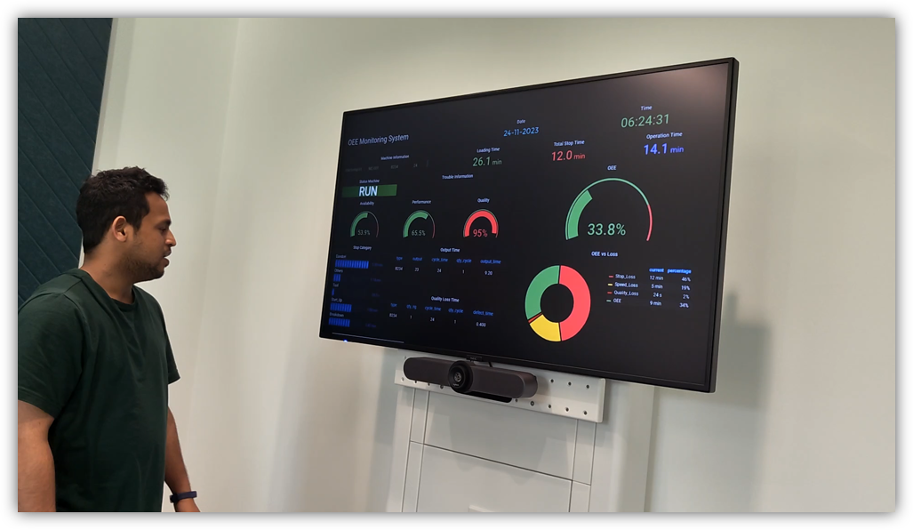
Industrial Voice Assistant Concept Demonstration
Link to Video

Slide 9
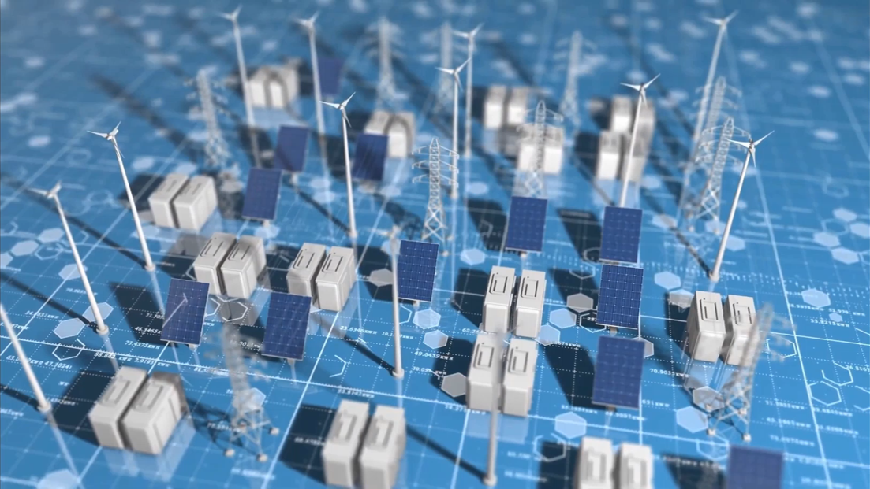
Link to Video

Slide 10

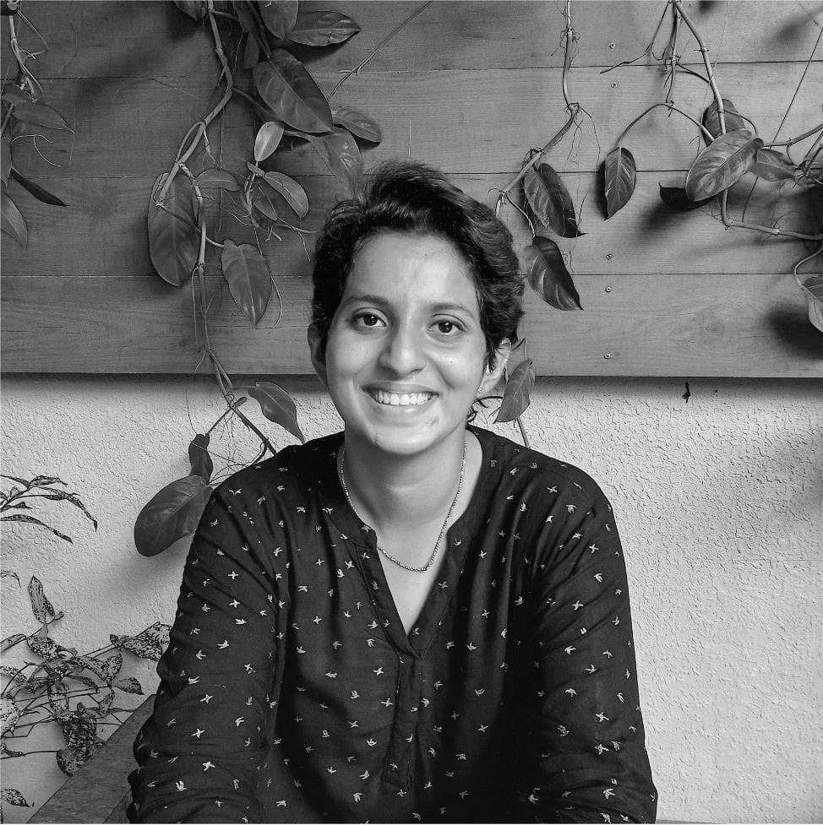


Meet Team Robotechs!!
Finny Varghese
finnyvarghese94@gmail.com
“Mechanical engineer with experience in Industrial automation, robotics, data analytics and digital twin, currently upskilling myself in Robotics”
Princy Mariam Jacob
princyy.mariam.jacob@gmail.com
“Physicist and a data science student currently mastering in robotics, interested in industrial automation and engineering”
Abhiram Karukayil
karukayilabhiram@gmail.com
“A mechatronics engineer with experience in robotics and vision-based control for industrial applications, currently doing my master’s in Robotics”

